Slide 1




16-18.02.2026 I IFEMA MADRID
next level
unlocked
Participation Guidelines – VIII Future Gastronomy Startup Forum

Slide 2


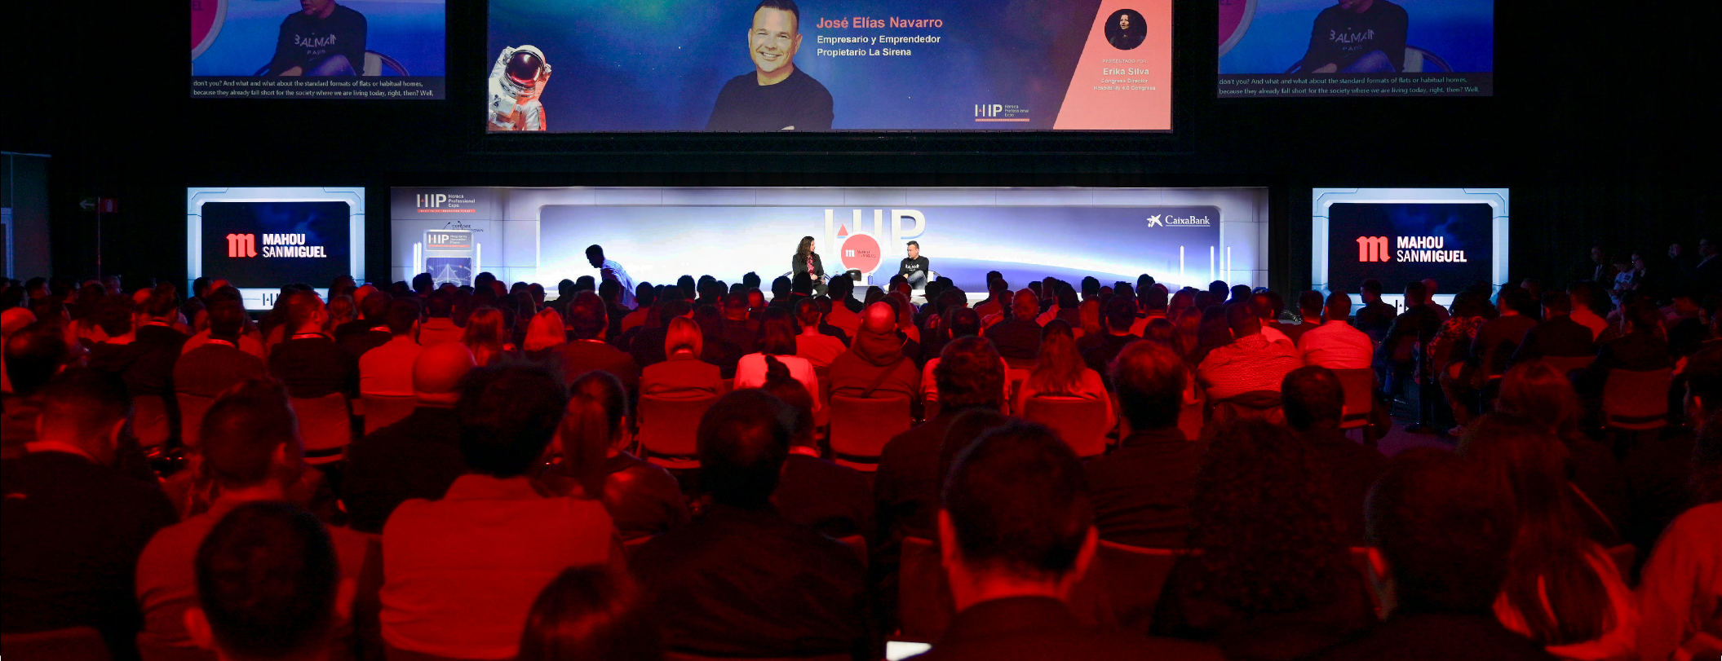
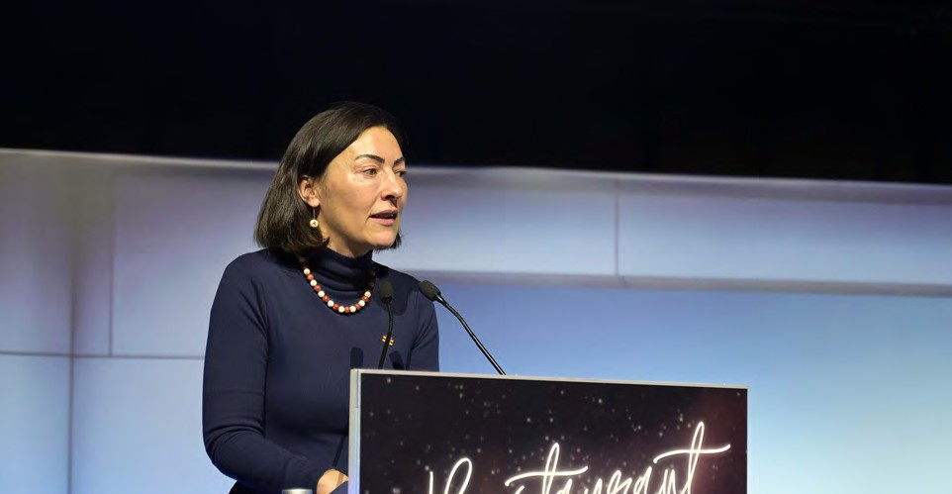

Bases – VIII Future Gastronomy Startup Forum
1. What is the Future Gastronomy Startup Forum?
We are looking for startups that are transforming gastronomy and the HORECA sector. At HIP 2026 (February 16–18 at IFEMA Madrid), the 8th edition of the Future Gastronomy Startup Forum will take place alongside GOe Gastronomy Open Ecosystem.
This forum is both an innovation showcase and a networking space with industry leaders, potential partners, and investors. We are seeking disruptive projects that impact both the back-office and front-office of hospitality through technologies such as AI, Big Data, analytics, IoT, robotics, automation, 3D printing, blockchain, or mixed realities.
Selected startups will have the opportunity to present their solutions to leading companies and investors in the sector. In the last edition, the winner was Gamb00za, which offered an AI and visual recognition solution to reduce costs and food waste.
#HIP2026

Slide 3
2. MAIN AREAS / SECTORS
New foods & innovative processes: Advanced ingredients and products (alternative proteins, fermentation, nutraceuticals), healthy/personalized foods, production technologies, automation and applied robotics.
Sustainability & circular economy: Sustainable/smart materials and packaging, traceability and safety, food waste reduction, reuse and shelf-life improvement, responsible logistics.
Culinary science & experience: Sensory and culinary sciences, 3D food printing, VR/AR applied to gastronomy, innovative machinery and equipment.
Future agriculture & production: Indoor farming, urban agriculture, connected and intelligent production systems.
Distribution, delivery & digital channels: Food delivery, on-demand models, logistics and traceability solutions, mobile platforms (ordering, reservations, payments, loyalty).
Smart hospitality & new experiences: Smart restaurants (management, operations, data, energy efficiency, trained teams), personalized customer experiences, innovative gastronomic tourism.
3. WHO CAN PARTICIPATE?
Startups, entrepreneurs and Technology Centers with innovative solutions in any of the mentioned areas or technologies are welcome to apply. The top 5 applications will be selected to pitch on 17 February 2026 in Madrid.
4. ¿CÓMO PARTICIPAR?
All projects must be submitted through the online application form.
After submission, organizers will check that the application has been correctly received and meets the requirements.
The Expert Committee will evaluate all proposals and select those that qualify.
Only selected projects will be able to participate in the Future Gastronomy Startup Forum – by GOe Gastronomy Open Ecosystem, held within HIP 2026 at IFEMA from 16–18 February.
#HIP2026

Slide 4
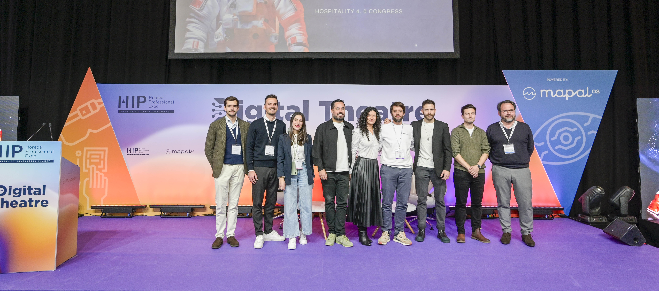
5. SELECTION CRITERIA
The Expert Committee—made up of collaborators and specialists from GOe – Gastronomy Open Ecosystem and Basque Culinary Center—will assess proposals based on:
Ability to address challenges in Gastronomy, HORECA and future societal needs
Technological component
Scalable, sustainable and international potential
Seed or early-stage (Series A) startups
Validated or tested MVP or Minimum Viable Product
B2B, B2C or B2B2C solutions Innovative and disruptive value (product/service, processes, business model...)
Founding team commitment and leadership potential Sustainability in the value proposition and business model
6. BENEFITS
Participating in the Future Gastronomy Startup Forum offers the opportunity to:
Showcase your company, product or service in an elevator-pitch format (in English or Spanish) in front of an international audience
Connect with the global innovation ecosystem shaping the future of gastronomy and Hospitality
Find partners to develop and scale your Project
Be considered for the Horeca New Business Models Awards 2026
#HIP2026

Slide 5

7. PRIZE
The winning startup will receive:
Membership in the GOe entrepreneurship community, with access to the Basque Culinary Center ecosystem, exclusive programming, and our network of experts, mentors, investors and industry professionals
10 hours of mentorship from GOe and Basque Culinary Center specialists
Soft-landing support in the Basque local ecosystem, including access to investors and potential partners
Opportunity to present the project at GOe entrepreneurship events
Two-month stay at GOe with full access to community programming
Two VIP passes to HIP 2026 (valued at €375 each)
8. DEADLINES
Applications accepted until 16 January 2026 (23:59 CET)
Selected projects notified from 23 January 2026
Final pitches held on 17 February 2026 at the Future Gastronomy Startup Forum – by Gastronomy Open Ecosystem
9. ORGANIZERS
NEBEXT organizes HIP 2026 – Horeca Professional Expo. Basque Culinary Center and GOe – Gastronomy Open Ecosystem organize the Future Gastronomy Startup Forum within HIP 2026.
10. DATOS DE CONTACTO
For questions or further information: goe@bculinary.com
If you are also interested in exhibiting or exploring participation options at HIP 2026, contact:
Phone: +34 919 551 551
Email: exhibit@expohip.com
Submitting an application implies full acceptance of these terms and conditions.
#HIP2026

Slide 6


www.expohip.com
#HIP2026

